Slide 1
Development of an Android Application for Pavement Roughness Estimation: Final Presentation
Team SDMAY20-17
Tanner Dempsay, Greg Starr, Joseph Van Treeck, Kyle Eckrich, Christian Royston, Justin Kuennen
Client
Program for Sustainable Pavement Engineering & Research (PROSPER) at Institute for Transportation, Bo Yang
Advisor
Halil Ceylan

Slide 2
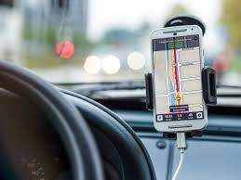
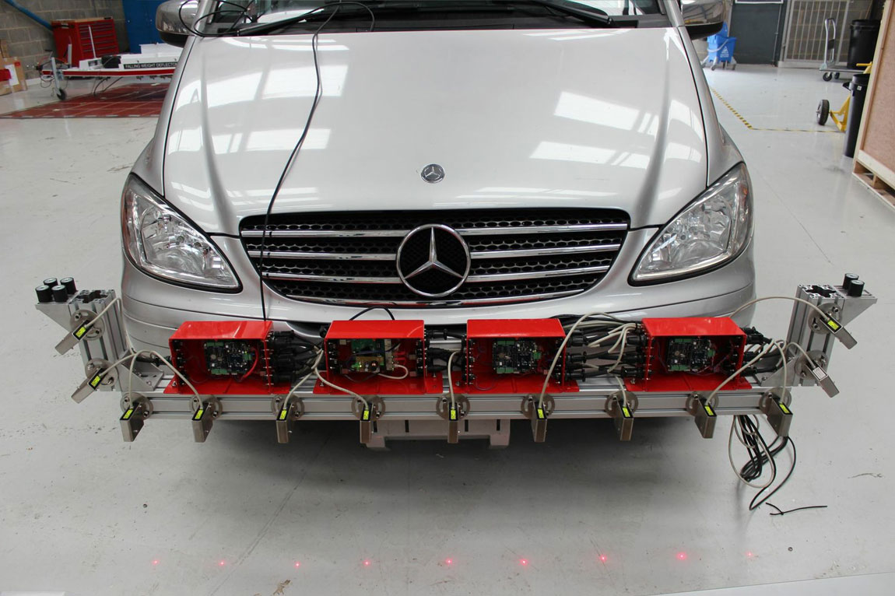
Problem Statement
Monitoring road quality is vital for properly allocating maintenance resources
Current solutions are pricey and complex
We are developing a cheap and easy way to measure pavement roughness
Using common Android smartphones to collect data while driving a vehicle, our goal is to develop an application to accurately calculate the International Roughness Index (IRI) of pavement
Example of Class 1 Profilometer
Phone mounted to car dash
Notes:
Joe

Slide 3
Project Requirements
Functional:
Application must record GPS and accelerometer data from device sensors
Create log of routes driven
Calculate IRI of routes
Must support a minimum of Android Nougat
Account system with user login
Database using MongoDB to maintain route data
NodeJS server to assist with realtime IRI calculation
Route data stored locally when cellular connection is weak
Ability to upload saved data for analysis when connection is restored
Nonfunctional:
Logging
Failed login attempts stored for auditing
Any runtime error should be logged for local file evaluation
Server
Server software must be independent of server OS
Must be able to handle up to 20 simultaneous users
App should be “easy” to use while user is driving vehicle
Notes:
Joe

Slide 4
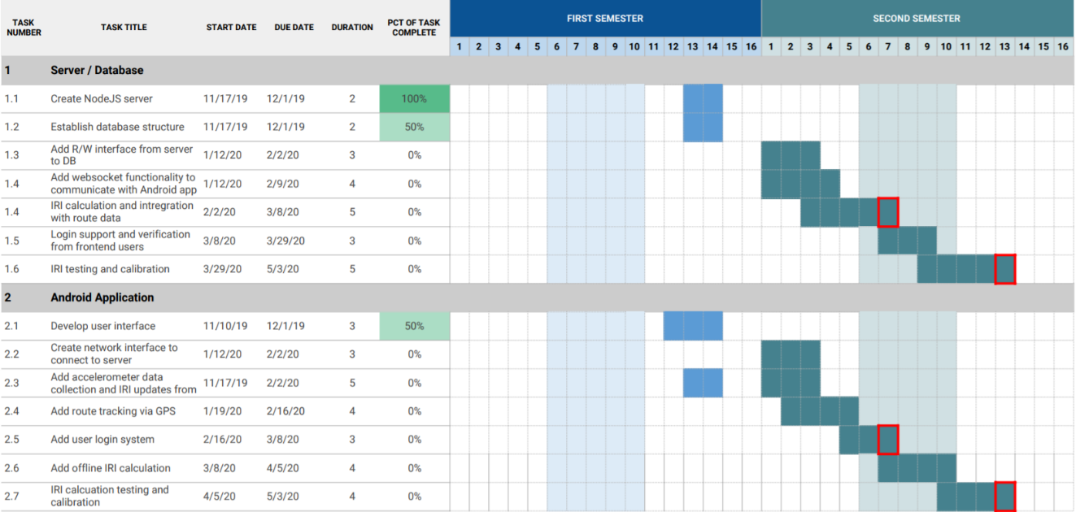
Project Schedule

Slide 5
System Design

Slide 6
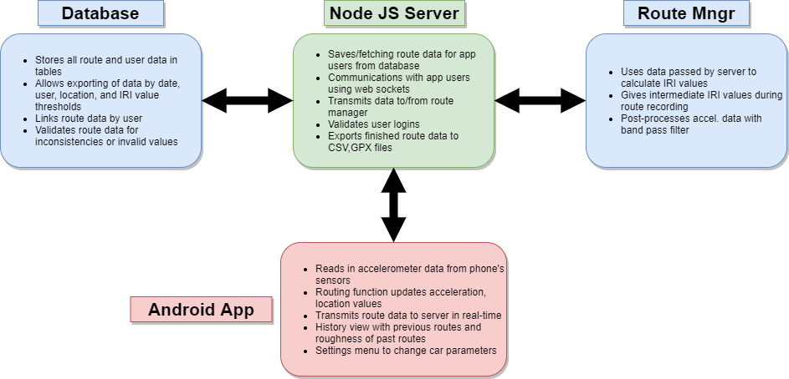
Conceptual Design Diagram
Notes:
kyle

Slide 7
Operating Requirements
Server
NodeJS
Socket.io, GPS-to-GPX, Express
Python 3+
Scipy, Matplotlib, GeoPy
MongoDB
Android Application
Android OS 7.0 + (API 24, Android Nougat)
GPS, accelerometer hardware
Internet connection
Optional: local storage R/W

Slide 8
Cost Estimate
Android Smartphone: $150
One minimum,
Meets hardware requirements
Server machine: $300
Compatible with operating requirements
Recommended 8GB RAM, 2 CPU minimum
Total Cost: $450 from scratch

Slide 9
Server
Communication with app using socket event listeners,emitters
Listener modules
User Management
Route Management
Data Management
Spawns Python route manager
Communication via pipes, serialized data
On route finish, CSV and GPX files are exported to output directory
Retrieved via /output/csv, /output/gpx URLs on server
Route data also written to DB
Notes:
Kyle
Socket handlers implemented for all major functionalities on frontend (login, route data transfer, etc.)
Login and signup request from frontend successfully validated using DBentry reads
Route handlers pass data back and forth to Python script via stdin/out pipes
gpx files can be used to emulate movement with Android emulator
Data is pushed to database and exported as .csv and .gpx files on server

Slide 10
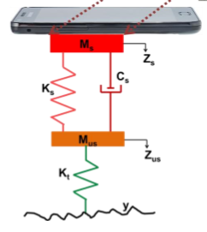
System Design: Roughness Calculation
Based on Quarter Car model
International Roughness Index (IRI)
Total vertical displacement over distance traveled
Inputs gathered by smartphone
Acceleration(x,y,z)
Latitude, longitude
Time
Inputs gathered through calculation
Vertical velocity and displacement
Road profile (unsprung displacement)
Distance between points
Notes:
Tanner

Slide 11
Python Route Manager
Live IRI calculation
Acceleration and GPS data continually sent during record
Pavement displacement is calculated by integrating acceleration data
Post route data processing
Acceleration data is vulnerable to noise during the collection
A more accurate IRI can be calculated after filtering and processing our data
Butterworth filter to reduce effects from unwanted frequency range
Standalone
Can run tool without server
CSV of route data given as argument
Notes:
Joe

Slide 12
Android App: User Interface
Navigation bar to main fragments
Route Recording
Route Details
Settings
Login/Signup
Username and password
Route History
View previous routes
Each has their own route details view
Route Details
In depth data of route
Map view with route overlayed
Settings
Select vehicle preset
Modify car details such as mass,suspension coeff, etc.

Slide 13
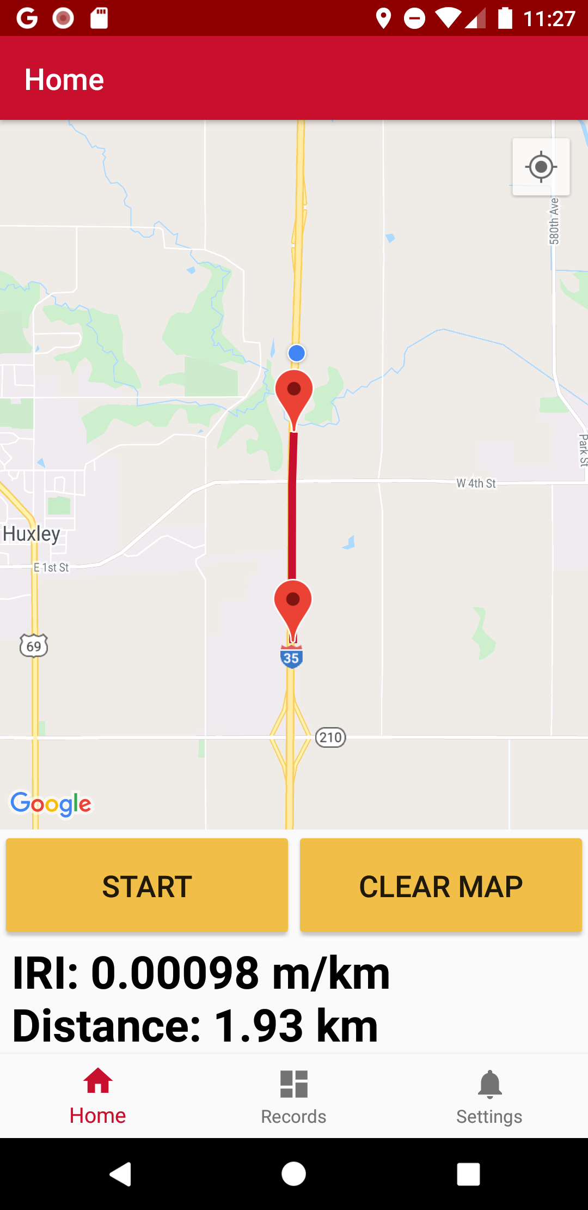
Android App: Route Recording
Google Map View
Route traced during recording
Markers for start, end of route
Route Record Task
Extends TimerTask class
Scheduled at 1ms (actual ~2ms)
Reuses objects to reduce garbage collection
Data recorded
Acceleration (x,y,z)
Latitude,Longitude
Timestamp
Statistic Textview
“Rough” IRI value (m\km)
Route distance (km)
Updates during recording ~500ms
Notes:
Tanner

Slide 14
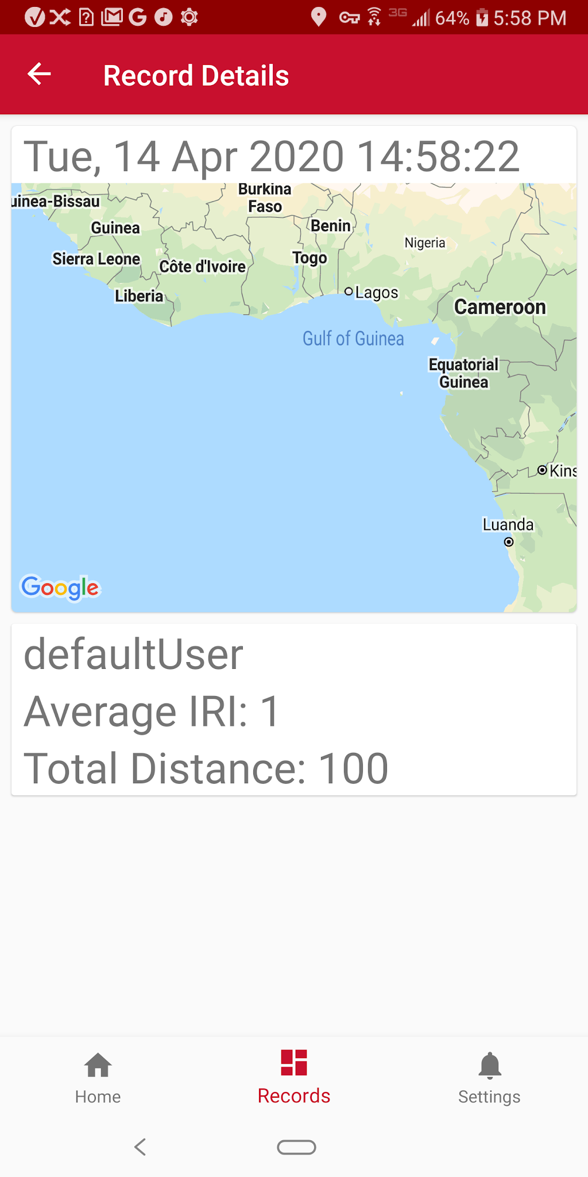
System Design: User Interface
Login/Signup
User ID and password
Route Recording
Map at current location
Overview of route data
Route History
View previous routes
Each has their own route details view
Route Details
In depth data of route
Map view with route overlayed
Settings
Input current vehicle type
Calibrate phone sensor based on orientation
Notes:
Christian

Slide 15
Test Plan: Methodology
Each requirement is associated with test case(s)
Cases may represent >1 physical test
Successful test results in all cases verifies software functionality outlined in requirements
Software tests will be developed iteratively
Same schedule as feature development in tasks
Per interface/module
Follows 4-layer software testing life cycle: Unit, Integration, System, Acceptance
Upper level tests require lower level modules to be verified
Notes:
Tanner

Slide 16
Test Plan: Tools and Frameworks
Android Application
Device Emulation
Rapid development and debugging
Test application on various device/OS configurations
Espresso
Tests using application’s user interface
Automate UI interactions for rapid prototyping
Android Profiler
Measure resource usage of application in real time
Includes CPU, memory, battery, and network
Node.js Server
Mocha
JavaScript unit tests
Test runtime option to evaluate module performance
Notes:
Tanner
Android application

Slide 17
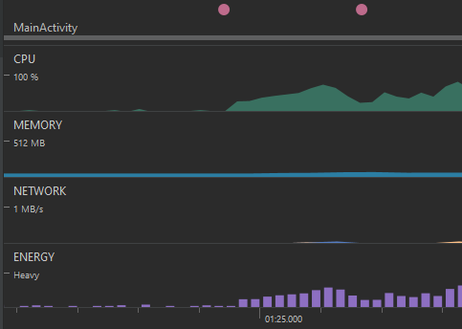
Testing Results
Due to time constraints + circumstances, formal testing was limited
System/Integration testing
Verified each socket emit/listen event connected to local and remote server instance
Demonstrated data acquisition and storage preserved correct values
Final Report includes implementation-specific results of requirement testing
Android Profiler
“Idle”
CPU: <10%
Battery Usage: Light
Route Record
CPU: 60-70%
Battery Usage: Medium
Android profiler stats, idle vs route recording (Pixel 3a, Android OS 7.0)

Slide 18
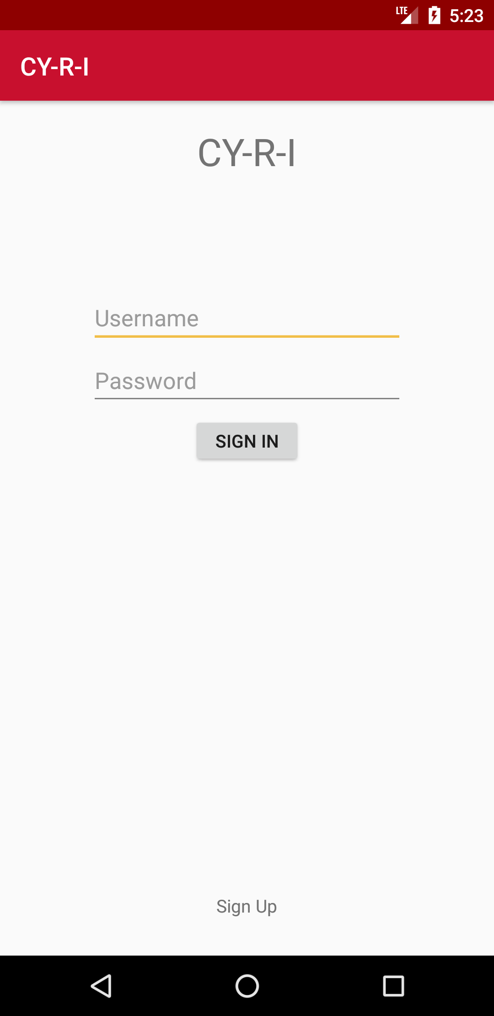
Project Results: Frontend
Completed and refined all layouts for the app
Login System Complete
Able to record routes and send to server for calculation
Place to view history of routes in more detail
Settings menu finished

Slide 19
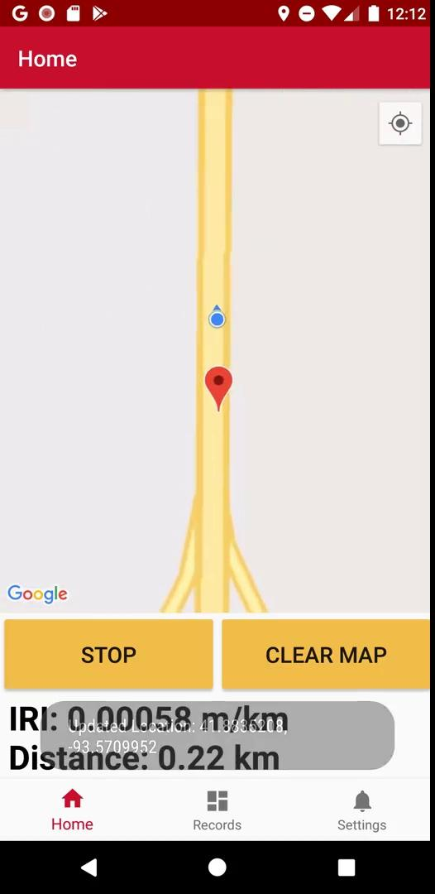
Project Results: Frontend

Slide 20
Engineering Standards and Design Practices
AGILE project management
Websocket protocol IETF RFC 6455
Code Documentation
Top-down software development
Notes:
Internet Engineering Task Force (IETF)
Request for Comments (RFC)

Slide 21
Conclusion

Slide 22
What Went Wrong
IRI Issues
No access to known IRI values, and no means to collect accurate IRI values
Made developing/adjusting IRI calculation very difficult
Not enough preliminary research on quarter-car model
Spent much time trying to calculate IRI through finding transfer function, convolving
Solution not possible, as system is unstable
Time Management
Should have started development earlier to help acclimation to tools

Slide 23
What We’ve Learned
Javascript
MongoDB
Android UI development using fragments
Raw data filtering techniques

Slide 24
Individual Efforts
Team Member | Member Role | Contributions
Greg Starr | Frontend Designer | Map route drawing
Christian Royston | Frontend Designer | Login and signup logic and UI design on frontend application
Kyle Eckrich | Database Management and Interaction | Database creation, object format design for DB storage, Server <-> DB interface
Joe Van Treeck | IRI Calculation and Route Data Processing | IRI calculation design, testing, and implementation for Python tool
Justin Kuennen | Frontend Designer | Frontend navigation UI design and implementation, route history screen design
Tanner Dempsay | Server and Networking | Client,server networking Implementation route data management for Python tool, NodeJS <-> Python interfacing

Slide 25
Questions?

